Slide 1
Service Bus Durable Task Framework
Md Faisal Amin
1099272

Slide 2
Overview & Key Features
The Service Bus Durable Task Framework provides developers a means to write code orchestrations in C# using the .NET Task framework and the async/await keywords added in .NET 4.5.
The framework itself is very light weight and only requires an Azure Service Bus namespace and optionally an Azure Storage account.
Key Features:
Definition of code orchestrations in simple C# code
Automatic persistence and check-pointing of program state
Versioning of orchestrations and activities
Async timers, orchestration composition, user aided check pointing

Slide 3
Scope of the Project
C# console application for Authentication & upload video on Dailymotion.
Durable Task Framework for task orchestration.

Slide 4
Core Concepts of Durable Task Framework
Task Hub: logical container for Service Bus entities within a namespace.
Task Activities: Task Activities are pieces of code that perform specific steps of the orchestration.
Task Orchestrations: Schedule Task Activities and build code orchestrations .
Task Hub Worker: host for Task Orchestrations and Activities.
Task Hub Client: APIs for creating and managing Task Orchestration instances and querying the state of Task Orchestration

Slide 5
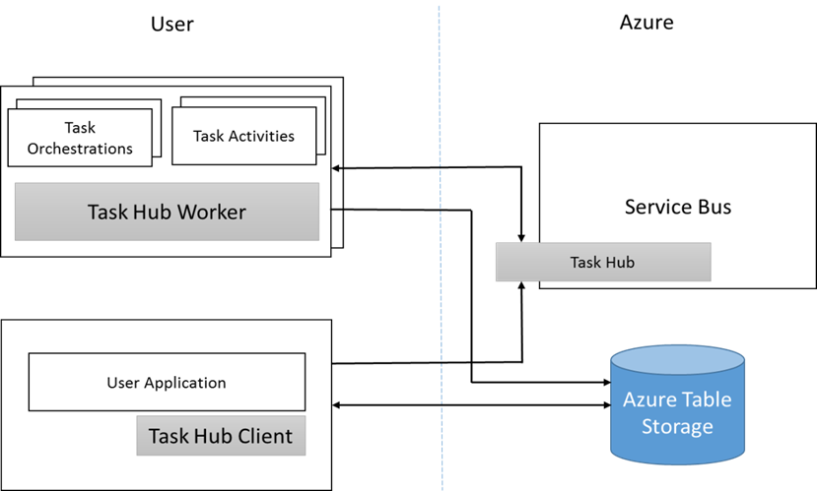
Figure of core components of the Framework

Slide 6
Module Design
Task Activities: GetAccesTokenTask.cs, UploadVideoTask.cs
TaskOrchestration: TaskOrchestration.cs

